Slide 1
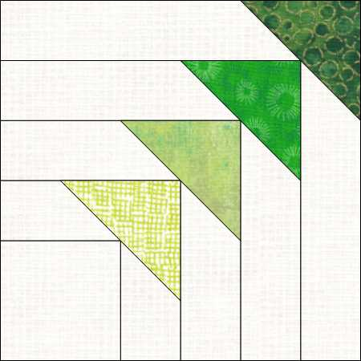
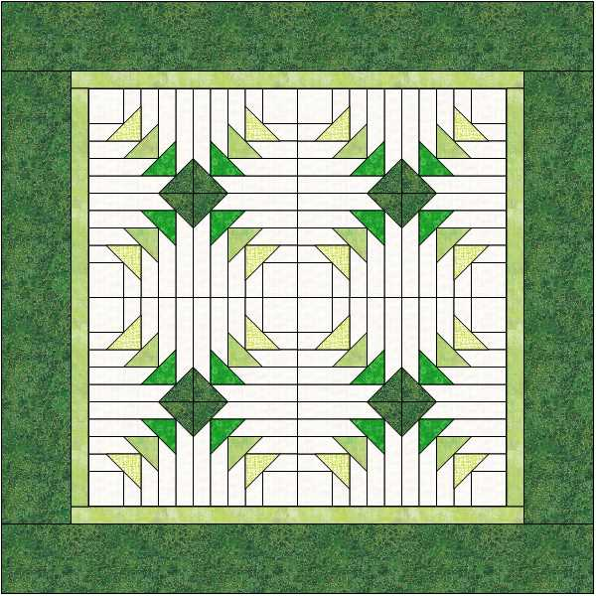
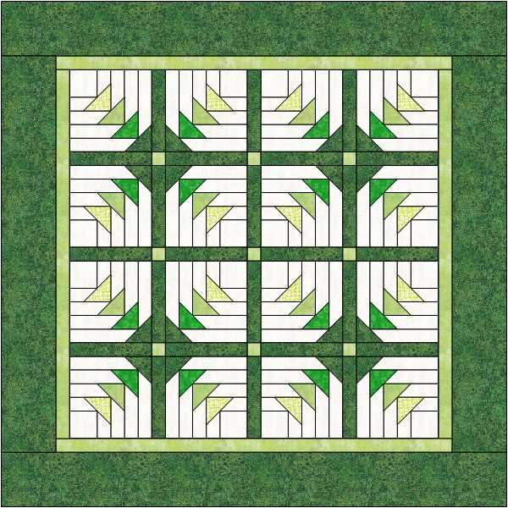
Geese on the Edge Technique Class
Measures 33” x 33”
6” Geese on the Edge Blocks (can be made in 10 sizes from 3” to 12”).
Requires Wing Clipper I and Tucker Trimmer I & Geese on the Edge Technique Sheet
Fabric Requirements:
Background – 1 ¼ yard
Cut: 16 – 2 ½” starter squares (1 WOF strip). Cut 16 – 1 ¾” WOF strips for logs (you may need more).
Replacement Triangles: 4 fat eights of different colors
Cut 8 – 3 ¼” squares from each color (32 total) and cut once diagonally.
Inner Border: ½ Yard (Inner border 1 ½” strips
Outer Border & Binding: 1 yard (outer Border 3 ½” strips. Increase to 2 yards if using sashing. Using sashing reduces the amount of the non-nesting seams.)
Jackie O’Brien Email sewjackie@live.com www.ifthesethreadscouldtalk.com

